Slide 1
Digital Image Processing Chapter 5: Basic Methods for Image Segmentation

Slide 2
Image Segmentation
Obtain a compact representation of the image to be used for further processing.
Group together similar pixels
Image intensity is not sufficient to perform semantic segmentation
Object recognition
Decompose objects to simple tokens (line segments, spots, corners)
Finding buildings in images
Fit polygons and determine surface orientations.

Slide 3
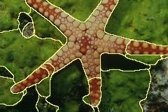
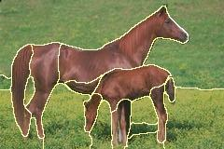
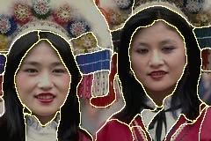
Image Segmentation
Goal: separate an image into “coherent” regions.
Basic methods
Point, line, edge detection
Thresholding
Region growing
Morphological watersheds
Advanced methods
Clustering
Model fitting.
Probabilistic methods.
…

Slide 4
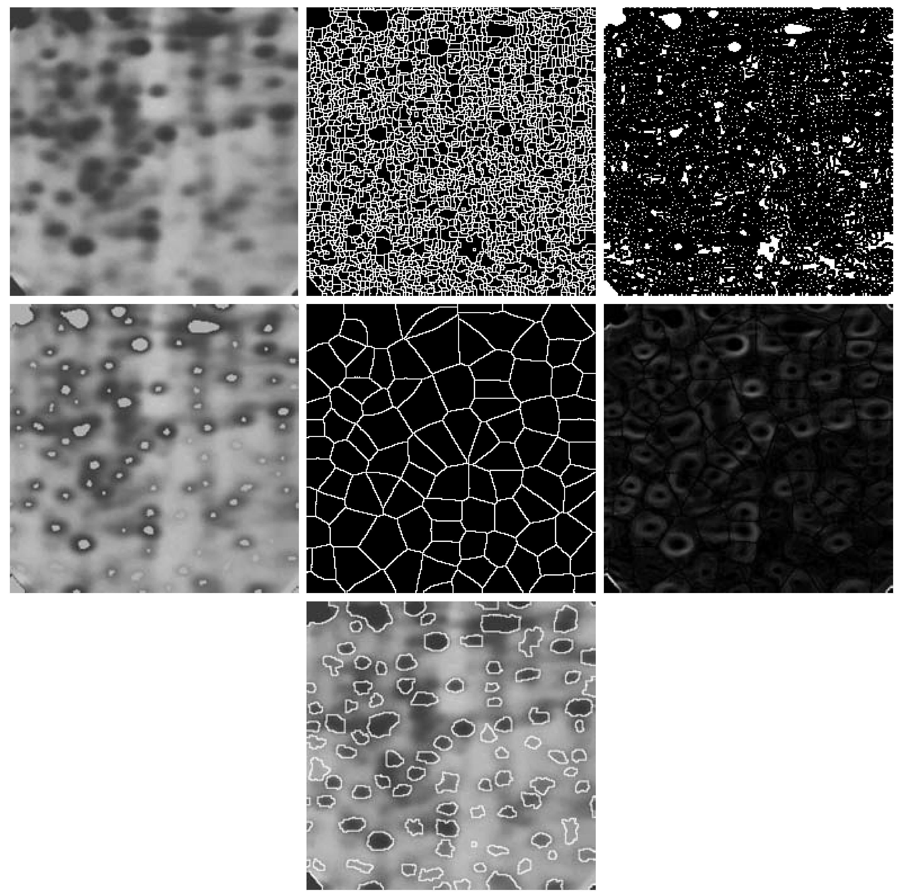
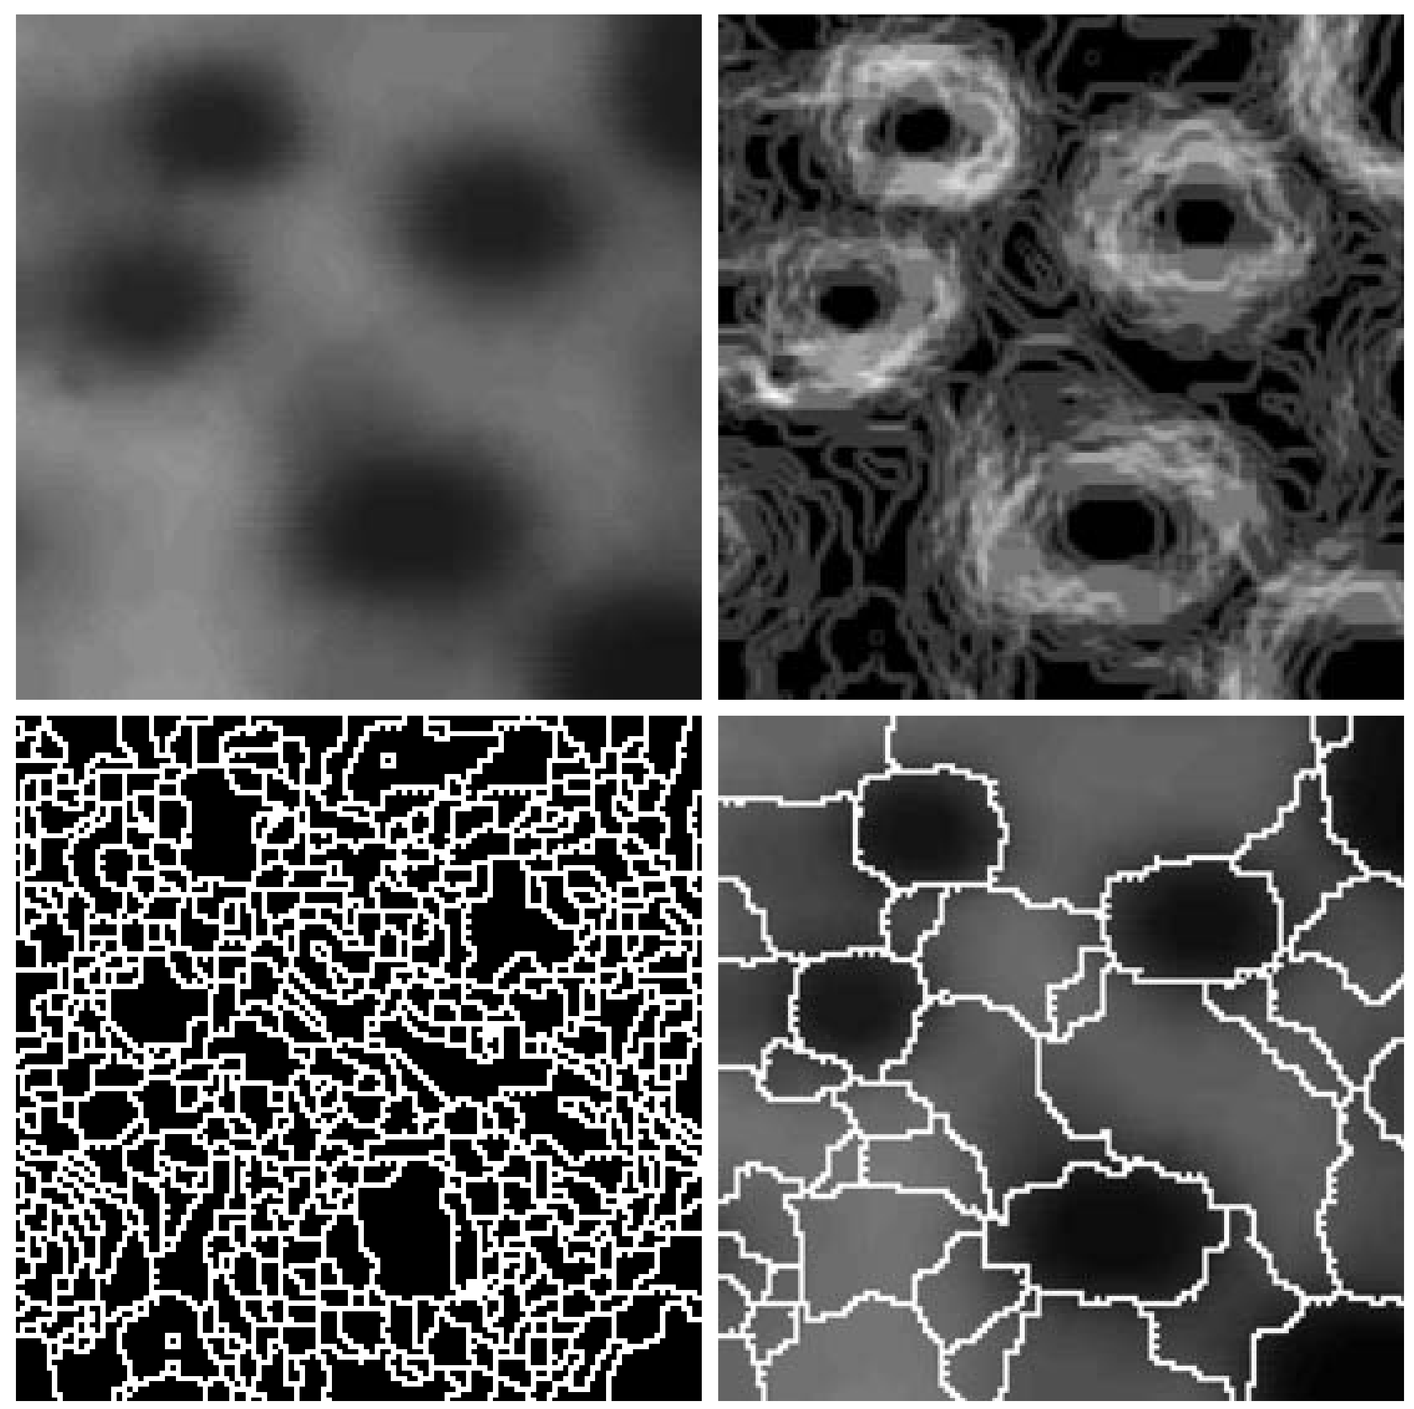
Image Segmentation

Slide 5
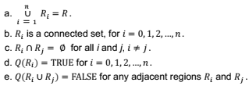
Image Segmentation: Fundamentals
Let R represent the entire spatial region occupied by an image. We may view image segmentation as a process that partitions R into n subregions, such that:
where Q(R_{k}) is a logical predicate defined over the points in set R_{k} and Ф is the null set. The symbols ᴜ and ∩ represent set union and intersection. Two regions R_{i} and R_{j} are said to be adjacent if their union forms a connected set. If the set formed by the union of two regions is not connected, the regions are said to disjoint.

Slide 6
Image Segmentation: Fundamentals
Fundamental problem in segmentation is to partition an image into regions that satisfy the preceding conditions.
Segmentation algorithms for monochrome images generally are based on one of two basic categories dealing with properties of intensity values: discontinuity and similarity.
Boundary detection based on local discontinuities in intensity: Edge-based segmentation
Similarity: Region-based segmentation approaches (partitioning an image into regions that are similar according to a set of predefined criteria)

Slide 7
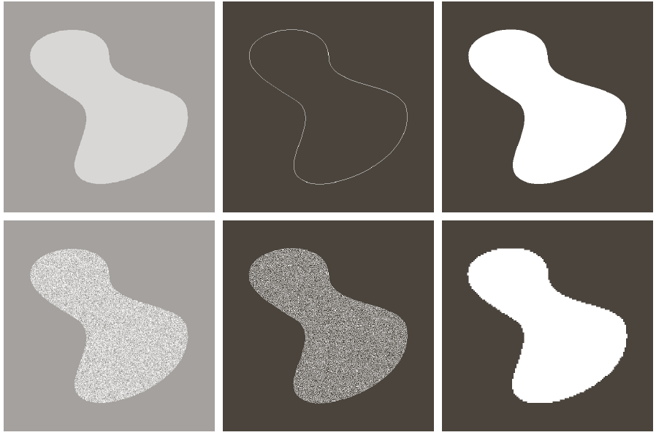
Image Segmentation: Fundamentals
Edge information is in general not sufficient.
Constant intensity
(edge-based
segmentation)
Textured region
(region-based
segmentation)

Slide 8
Edge-Based Segmentation

Slide 9
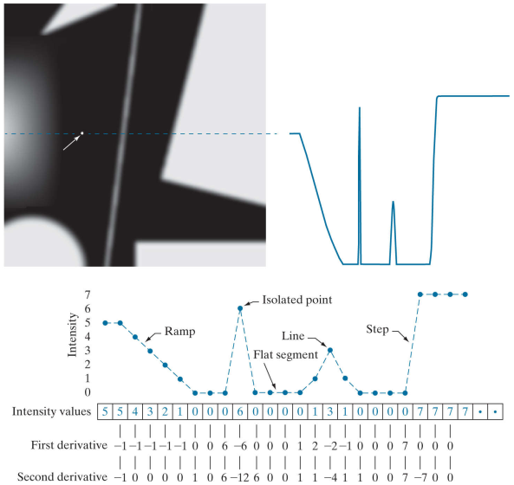
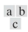
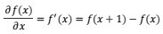
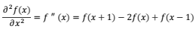
Point, Line and Edge Detection
(a) Image. (b) Horizontal intensity profile that includes the isolated point indicated by the arrow. (c) Subsampled profile; the dashes were added for clarity. The numbers in the boxes are the intensity values of the dots shown in the profile.
The derivatives were obtained using Eq. (1) for the first derivative and Eq. (2) for the second.
(1)
(2)

Slide 10
Point, Line and Edge Detection
First order derivatives produce thick edges at ramps.
Second order derivatives are non zero at the onset and at the end of a ramp or step edge (sign change).
Second order derivatives respond stronger at isolated points and thin lines than first order derivatives.

Slide 11
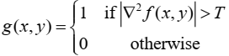
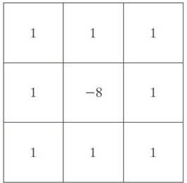
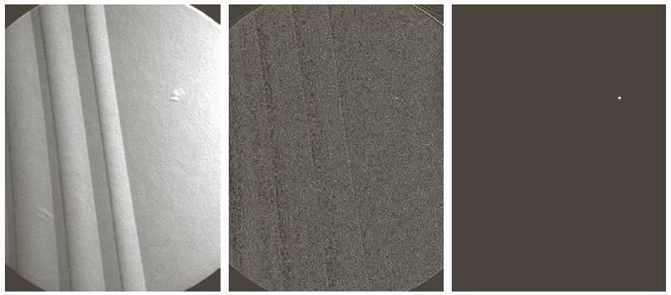
Detection of Isolated Points
Simple operation using the Laplacian
a, b, c, d
(a) Laplacian kernel used for point detection. (b) X-ray image of a turbine blade with a porosity manifested by a single black pixel. (c) Result of convolving the kernel with the image. (d) Result of using Eq. (10-15) was a single point (shown enlarged at the tip of the arrow).

Slide 12
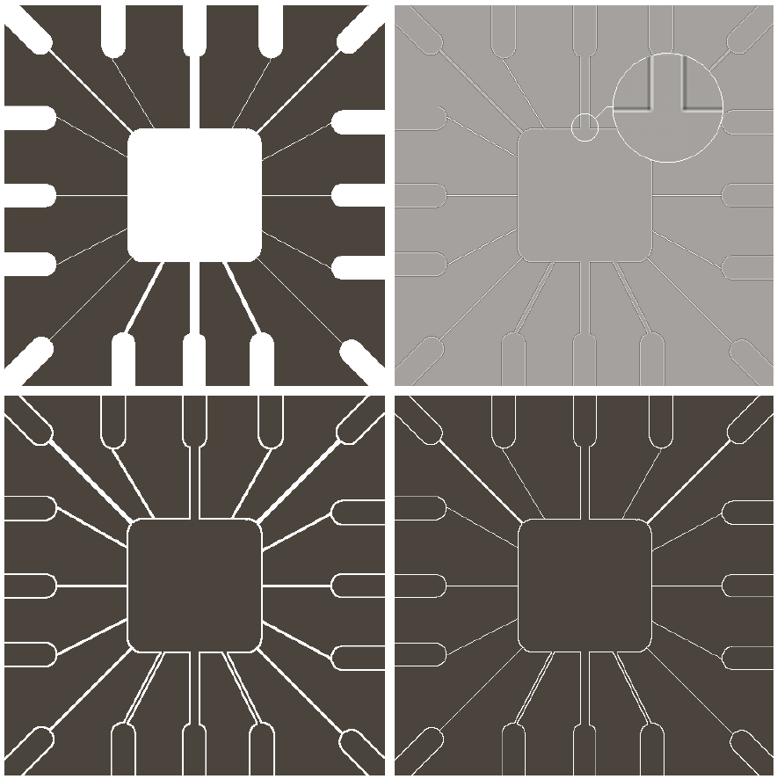
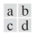
Line Detection
The Laplacian is also used here.
It has a double response
Positive and negative values at the beginning and end of the edges.
Lines should be thin with respect to the size of the detector
(a) Original image. (b) Laplacian image; the magnified section shows the positive/negative double-line effect characteristic of the Laplacian. (c) Absolute value of the Laplacian. (d) Positive values of the Laplacian

Slide 13
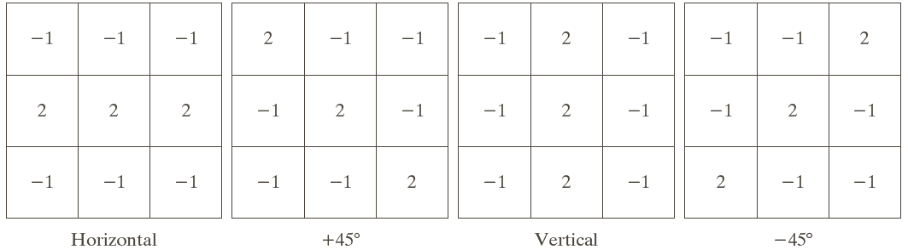
Line Detection
The Laplacian is isotropic.
Direction dependent filters localize 1 pixel thick lines at other orientations (0, 45, 90).
Line detection kernels. Detection angles are with respect to the axis system, with positive angles measured counterclockwise with respect to the (vertical) x-axis.

Slide 14
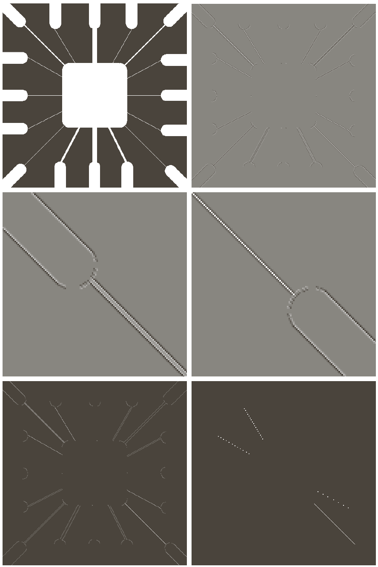
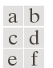
Line Detection
(a) Image of a wire-bond template. (b) Result of processing with the line detector kernel in Fig. 10.6 . (c) Zoomed view of the top left region of (b). (d) Zoomed view of the bottom right region of (b). (e) The image in (b) with all negative values set to zero. (f) All points (in white) whose values satisfied the condition where g is the image in (e) and (the maximum pixel value in the image minus 1). (The points in (f) were enlarged to make them easier to see.)

Slide 15
Edge Detection
What is an edge:
Edges are significant local changes of intensity in an image.
Edges typically occur on the boundary between two different regions in an image.
Goal of edge detection:
Produce a line drawing of a scene from an image of that scene.
Important features can be extracted from the edges of an image (e.g., corners, lines, curves).
These features are used by higher-level computer vision algorithms (e.g., recognition).

Slide 16

Edge Detection
Edge models:
Ideally, edges should be 1 pixel thin.
In practice, they are blurred and noisy.
From left to right, models (ideal representations) of a step, a ramp, and a roof edge, and their corresponding intensity profiles.

Slide 17
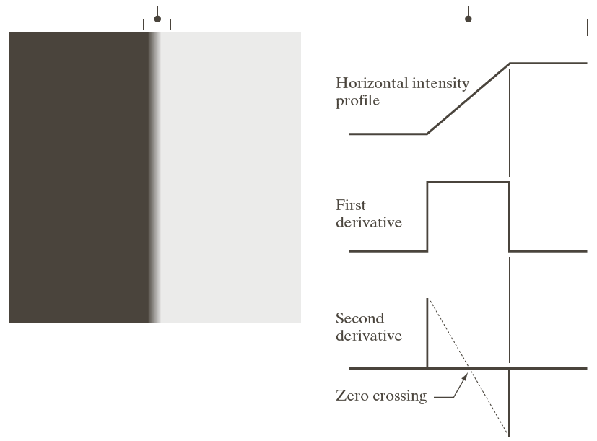
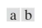
Edge Detection
(a) Two regions of constant intensity separated by an ideal ramp edge. (b) Detail near the edge, showing a horizontal intensity profile, and its first and second derivatives.

Slide 18
Edge Detection
Edge point detection
Magnitude of the first derivative.
Sign change of the second derivative.
Observations:
Second derivative produces two values for an edge (undesirable).
Its zero crossings may be used to locate the center of thick edges.

Slide 19
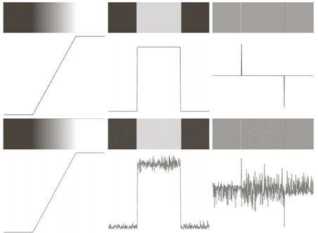
Edge Model and Noise

Slide 20
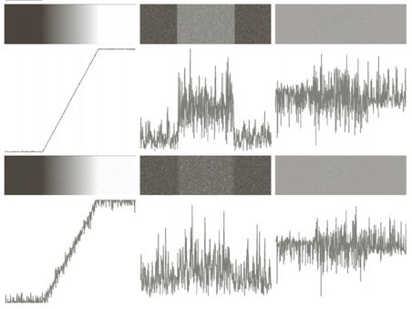
Edge Model and Noise

Slide 21
Fundamental Steps in Edge Detection
Image smoothing for noise reduction.
Derivatives are very sensitive to noise.
Detection of candidate edge points.
Edge localization.
Selection of the points that are true members of the set of points comprising the edge.

Slide 22

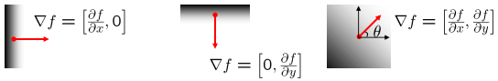
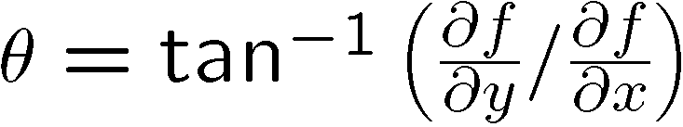
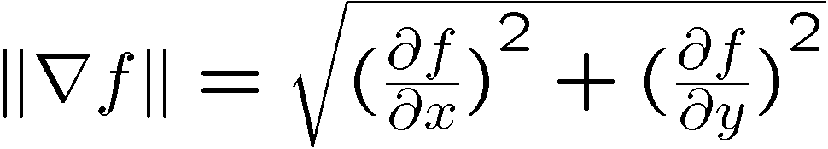
Image Gradient
The gradient of an image:
The gradient points in the direction of most rapid increase in intensity.
The gradient direction is given by:
The edge strength is given by the gradient magnitude:

Slide 23
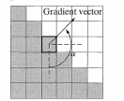
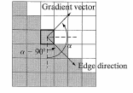
Image Gradient

Slide 24
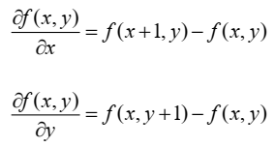
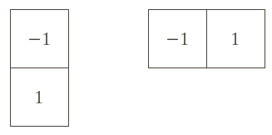
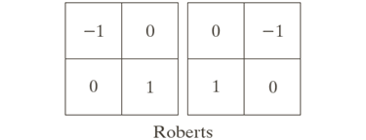
Gradient Operators
1D operator Roberts operator

Slide 25
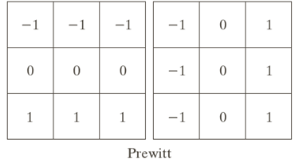
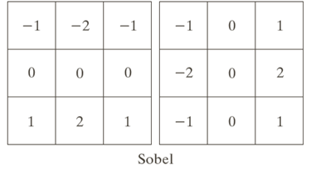
Gradient Operators: Vertical and Horizontal

Slide 26
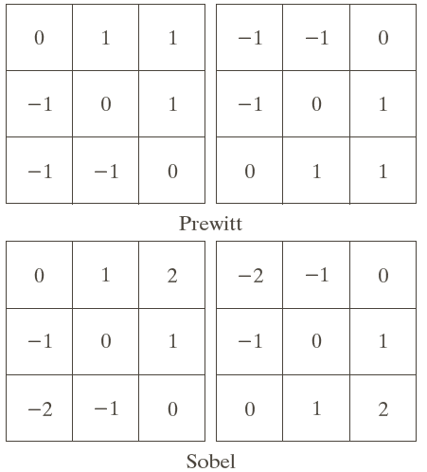
Gradient Operators: Diagonal

Slide 27
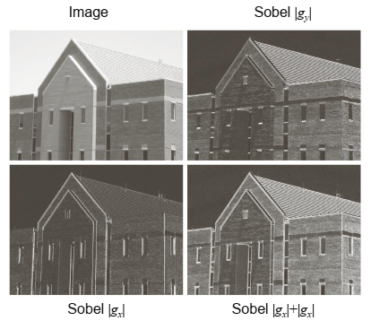
Gradient Operators: Example
Not smoothed

Slide 28
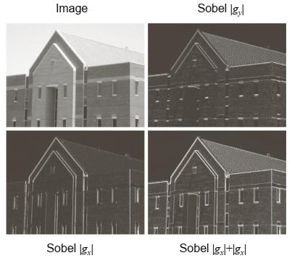
Gradient Operators: Example
Smoothed

Slide 29
Laplace Operator
0
1
0
1
-4
1
0
1
0
Notes:
29

Slide 30
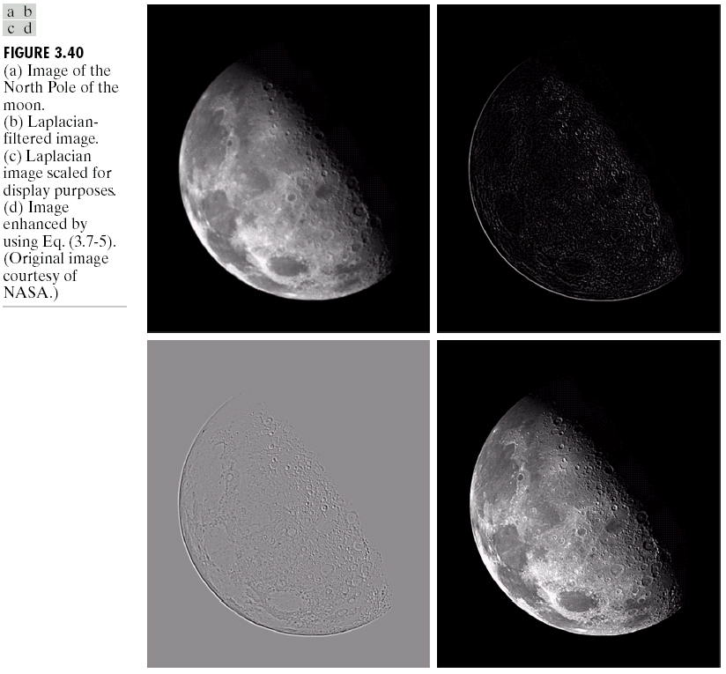
Laplace Operator
Original Image
Laplacian Filtered Image
Laplacian Filtered Image Scaled for Display
Notes:
30
Scaling: fm = f – fmin => fscaled = 255 (fm/fmax). Sau khi biến đổi, giá trị mức xám sẽ trong khoảng từ [0,255].
Ảnh khi qua bộ lọc laplacian phần lớn là màu đen vì sau khi lọc có những giá trị âm và những giá trị này đều được đưa về 0.

Slide 31
Laplace Operator: Image Enhancement
-
=
Original Image
Laplacian Filtered Image
Sharpened Image
Notes:
31

Slide 32
Laplace Operator: Image Enhancement
Notes:
32

Slide 33
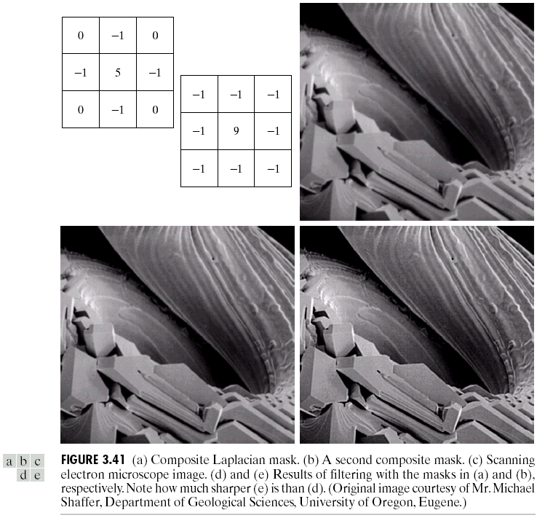
Laplace Operator: Image Enhancement
0
-1
0
-1
5
-1
0
-1
0
Notes:
33

Slide 34
Laplace Operator: Image Enhancement
0
1
0
1
1
1
1
-4
1
1
-8
1
Simple Laplacian
Variant of Laplacian
0
1
0
1
1
1
-1
-1
-1
-1
9
-1
-1
-1
-1
Notes:
34

Slide 35
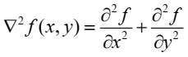
The Laplacian of Gauss – LoG Operator
A good place to look for edges is the maxima of the first derivative or the zeros of the second derivative.
The 2D extension approximates the second derivative by the Laplacian operator (which is rotationally invariant):
Marr and Hildreth [1980] argued that a satisfactory operator that could be tuned in scale to detect edges is the Laplacian of the Gaussian - LoG

Slide 36
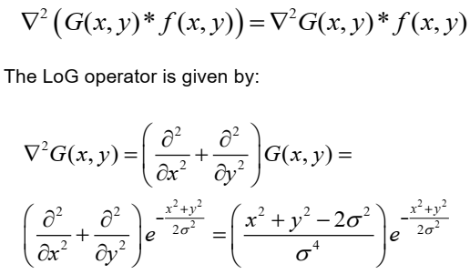
The Laplacian of Gauss – LoG Operator

Slide 37
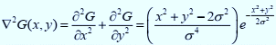
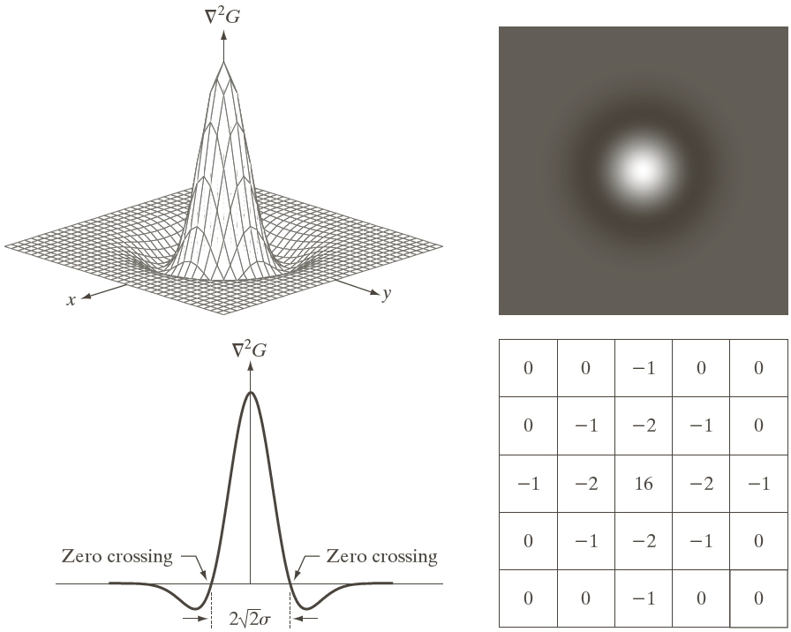
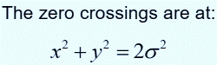
The Laplacian of Gauss – LoG Operator

Slide 38
The Laplacian of Gauss – LoG Operator
Fundamental ideas:
The Gaussian blurs the image. It reduces the intensity of structures at scales much smaller than σ.
The Laplacian is isotropic and no other directional mask is needed.
The zero crossings of the operator indicate edge pixels. They may be computed by using a 3x3 window around a pixel and detect if two of its opposite neighbors have different signs (and their difference is significant compared to a threshold).

Slide 39
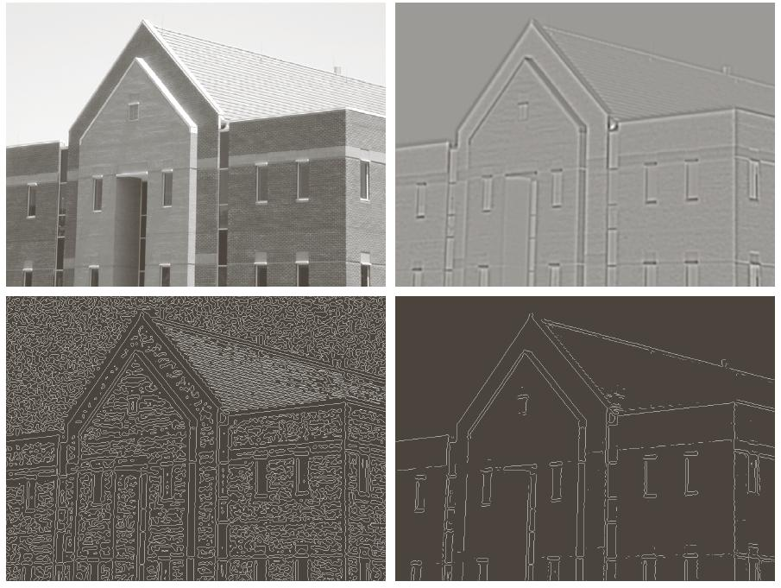
The Laplacian of Gauss – LoG Operator
a, b
c, d
a) Image b) LoG c) Zero crossings d) Zero crossings with a threshold of 4% of the image max

Slide 40
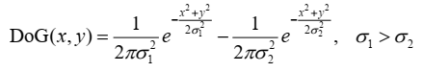
The Difference of Gauss – DoG Operator
Filter the image at various scales and keep the zero crossings that are common to all responses.
Marr and Hildreth [1980] showed that LoG may be approximated by a Difference of Gauss - DoG:
Certain channels of the human visual system are selective with respect to orientation and frequency and can be modeled by a DoG with a ratio of standard deviations of 1.75.

Slide 41
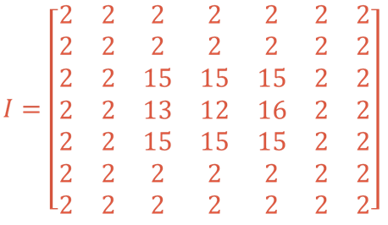
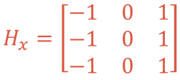
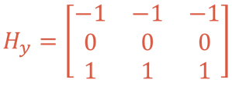
Edge Detection: Practice
Given the image I and operators H:
Convolve H with I and show the result.

Slide 42
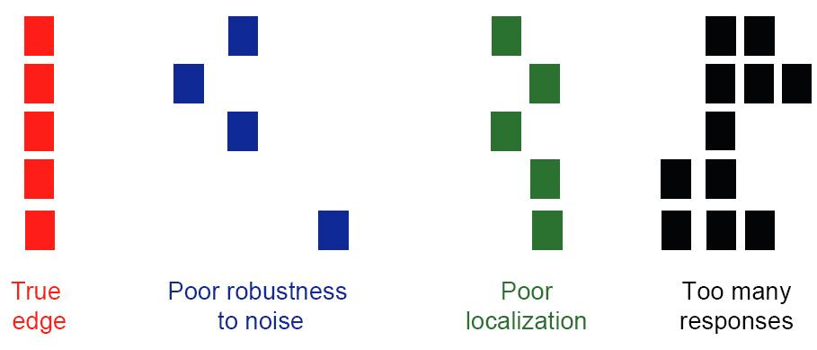
Designing an Optimal Edge Detector
Criteria for an “optimal” edge detector [Canny 1986]:
Good detection: the optimal detector must minimize the probability of false positives (detecting spurious edges caused by noise), as well as that of false negatives (missing real edges).
Good localization: the edges detected must be as close as possible to the true edges
Single response: the detector must return one point only for each true edge point; that is, minimize the number of local maxima around the true edge.

Slide 43
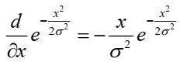
Canny Edge Detector (J. Canny’1986)
Probably the most widely used edge detector.
Theoretical model: step-edges corrupted by additive Gaussian noise.
Canny has shown that the first derivative of the Gaussian closely approximates the operator that optimizes the product of signal-to-noise ratio and localization.

Slide 44
Flow-chart of Canny Edge Detector (J. Canny’1986)
Original image
Smoothing by Gaussian convolution
Differential operators along x and y axis
Non-maximum suppression
finds peaks in the image gradient
Hysteresis thresholding locates edge strings
Edge map

Slide 45
Canny Edge Detector (J. Canny’1986)
1. Filter image with derivative of Gaussian.
2. Find magnitude and orientation of gradient.
– E.g. by using 1D, Roberts, Prewitt or Sobel operators
3. Non-maximum suppression:
– Thin multi-pixel wide “ridges” down to single pixel width.
4. Linking and thresholding (hysteresis):
– Define two thresholds: low and high
– Use the high threshold to start edge curves and the low threshold to continue them.

Slide 46

Canny Edge Detector (J. Canny’1986)
For example: a 5x5 Gaussian filter

Slide 47



Non-maximum suppression - NMS
At pixel q, we have a maximum if the value of the gradient magnitude is larger than the values at both p and at r.
Interpolation provides these values.

Slide 48

Non-maximum suppression - NMS

Slide 49

Predict the next edge point
Assume the marked point is an edge point.
Then we construct the tangent to the edge curve (which is normal to the gradient at that point) and use this to predict the next points (here either r or s).

Slide 50

Edge Direction
Every edge has two possible orientations. For example, an edge whose normal is oriented at and an edge whose normal is oriented at are the same horizontal edge
(a) Two possible orientations of a horizontal edge (shaded) in a neighborhood. (b) Range of values (shaded) of the direction angle of the edge normal for a horizontal edge.
(c) The angle ranges of the edge normals for the four types of edge directions in a neighborhood. Each edge direction has two ranges, shown in corresponding shades

Slide 51

Hysteresis Thresholding
Reduces false edge pixels. It uses a low (T_{L}) and a high threshold (T_{H}) to create two additional images from the gradient magnitude image g(x,y):
g_{L}(x,y) has more non zero pixels than g_{H}(x,y).
We eliminate from g_{L}(x,y) all the common non zero pixels:
g_{L}(x,y) and g_{H}(x,y) may be viewed as weak and strong edge pixels.
Canny suggested a ratio of 2:1 to 3:1 between the thresholds.

Slide 52

Canny Edge Detector (J. Canny’1986)

Slide 53




Canny Edge Detector (J. Canny’1986)
Sobel
LoG
Canny

Slide 54




Canny Edge Detector (J. Canny’1986)
Sobel
LoG
Canny

Slide 55




Canny Edge Detector (J. Canny’1986)
Sobel
LoG
Canny

Slide 56


Edge Detection: Practice
Given the image I and operators H:
Convolve H with I and show the result.

Slide 57
Region-Based Segmentation

Slide 58
Thresholding
Because of its intuitive properties, simplicity of implementation, and computational speed, image thresholding enjoys a central position in applications of image segmentation.
In this section, we discuss thresholding in a more formal way, and develop techniques that are considerably more general than what has been presented thus far.
In the previous section, regions were identified by first finding edge segments, then attempting to link the segments into boundaries.
In this section, we discuss techniques for partitioning images directly into regions based on intensity values and/or properties of these values.

Slide 59
Thresholding
Fixed threshold: use a threshold that is chosen independently of the image data.
If it is known that one is dealing with very high contrast images where the objects are very dark and the background is homogeneous and very light, then a constant threshold of 128 on a scale of 0 to 255 might be sufficiently accurate. By accuracy we mean that the number of falsely-classified pixels should be kept to a minimum.
Histogram-derived thresholds: threshold is chosen from the brightness histogram.
Require histogram processing techniques

Slide 60


Thresholding

Slide 61

Histogram Smoothing
Many of thresholding algorithms can benefit from a smoothing of the raw histogram data to remove small fluctuations but the smoothing algorithm must not shift the peak positions.
So before thresholding, a zero-phase smoothing algorithm is given below where typical values for W are 3 or 5:

Slide 62


Thresholding
Image partitioning into regions directly from their intensity values.
Intensity histograms that can be partitioned (a) by a single threshold, and (b) by dual thresholds

Slide 63


Noise in Thresholding
Difficulty in determining the threshold due to noise
(a) Noiseless 8-bit image. (b) Image with additive Gaussian noise of mean 0 and standard deviation of 10 intensity levels. (c) Image with additive Gaussian noise of mean 0 and standard deviation of 50 intensity levels. (d) through (f) Corresponding histograms.

Slide 64

Illumination in Thresholding
Difficulty in determining the threshold due to non-uniform illumination
(a) Noisy image. (b) Intensity ramp in the range [0.2, 0.6]. (c) Product of (a) and (b). (d) through (f) Corresponding histograms.

Slide 65

Basic Global Thresholding
T = 125

Slide 66
Otsu’s Method

Slide 67
Otsu’s Method
Based on statistical decision theory.
Minimization of the average error of assignment of pixels to two (or more) classes.
Bayes decision rule may have a nice closed form solution to this problem provided
The pdf of each class.
The probability of class occurrence.
Pdf estimation is not trivial and assumptions are made (Gaussian pdfs).
Otsu (1979) proposed an attractive alternative maximizing the between-class variance.
Only the histogram of the image is used.

Slide 68
Otsu’s Method
1. Compute the normalized histogram of the input image: p_{i}=n_{i}/MN (i=0,1,…, L-1) where M, N are the image size.
2. Compute the cumulative sums:
3. Compute the cumulative means:
4. Compute the global mean:
5. Compute the between-class variance term:
Obtain the Otsu threshold k*, as the value of k for which is maximum. If the maximum is not unique, obtain k* by averaging the values of k corresponding to the various maxima detected.

Slide 69

Otsu’s Method

Slide 70

Otsu’s Method

Slide 71

Otsu’s Method

Slide 72
Otsu’s Method
Dealing with small structures
The histogram is unbalanced
• The background dominates
• No valleys indicating the small structure.
Idea: consider only the pixels around edges
• Both structure of interest and background are present equally.
• More balanced histograms
Use gradient magnitude or zero crossings of the Laplacian.
• Threshold it at a percentage of the maximum value.
• Use it as a mask on the original image.
• Only pixels around edges will be employed

Slide 73


Otsu’s Method
(a) Noisy image. (a) and (b) its histogram. (c) Mask image formed as the gradient magnitude image thresholded at the 99.7 percentile. (d) Image formed as the product of (a) and (c). (e) Histogram of the nonzero pixels in the image in (d). (f) Result of segmenting image (a) with the Otsu threshold based on the histogram in (e). The threshold was 134, which is approximately midway between the peaks in this histogram.

Slide 74

Otsu’s Method
Find the Otsu’s threshold for the image I below (L=6):

Slide 75

Otsu’s Method
Find the Otsu’s threshold for the image I below:

Slide 76
Otsu’s Method
Find the Otsu’s threshold for the image I below (L=10):

Slide 77
Iso-data Algorithm

Slide 78
Iso-data Algorithm
Select initial threshold estimate t₀.
Segment the image using t₀
Region G₁ (values ≤ t₀) and region G₂ (values > t₀)
Compute the average intensities m₁ and m₂ of regions G₁ and G₂ respectively.
Repeat until the change of T in successive iterations is less than Δt, i.e. |t_{k+1} – t_{k}|< Δt.

Slide 79
Iso-data Algorithm
Find the iso-data threshold for the image with the histogram listed below.
Assume t₀=5

Slide 80
Iso-data Algorithm

Slide 81
Background Symmetry Algorithm

Slide 82
Background Symmetry Algorithm
This technique assumes a distinct and dominant peak for the background that is symmetric about its maximum.
The technique can benefit from a pre-processing technique which is histogram smoothing.
The maximum peak (maxp) is found by searching for the maximum value in the histogram.
The algorithm then searches on the non-object pixel side of that maximum to find the given percentile p% point.

Slide 83

Background Symmetry Algorithm
The percentile, p%, of an unquantized brightness distribution is defined as that value of the brightness a such that:
In digital image processing, p(a) happens to be the normalized histogram of the image.

Slide 84

Background Symmetry Algorithm
In the figure below, the object pixels are located to the left of the background that peaks at brightness 183.
Then search in the right of that peak to locate, for example, p%=95%. At this brightness value, 5% of the pixels lie to the right of that value.

Slide 85

Background Symmetry Algorithm
In this image, this occurs at brightness 216. Then the threshold value is 183 – (216 – 183) = 150

Slide 86

Background Symmetry Algorithm
Using the background symmetry method, find a global threshold for the image with the histogram given below.
Let p% = 88%.

Slide 87
Triangle Algorithm

Slide 88

Triangle Algorithm
A line is constructed between the maximum of the histogram at brightness b_{max} and the lowest value b_{min} = (p=0)% in the image. The distance d between the line and the histogram h[b] is computed for all values of b from b = b_{min} to b = b_{max}.

Slide 89
Triangle Algorithm
The brightness value b_{o} where the distance between h[b_{o}] and the line is maximum is the threshold value.
This technique is particularly effective when the object pixels has a weak peak in the histogram.

Slide 90
Region Growing

Slide 91
Region Growing
Start with seed points S(x,y) and grow to larger regions satisfying a predicate Q.
Needs a stopping rule: no more pixels satisfy the criteria for inclusion in that region.
Algorithm
Find all connected components in S(x,y) and erode them to 1 pixel.
Form image f_{q}(x,y)=1 if f(x,y) satisfies the predicate Q.
Form image g(x,y)=1 for all pixels in f_{q}(x,y) that are
connected with to any seed point in S(x,y).
Label each connected component in g(x,y) with a different label.

Slide 92

Region Growing
The weld is very bright. The predicate Q used for region growing is to compare the absolute difference between a seed point and a pixel to a threshold. If the difference is below it we accept the pixel as crack.

Slide 93

Region Growing

Slide 94
Region Splitting and Merging

Slide 95
Region Splitting and Merging
Based on quadtrees (quad-images)
The root of the tree corresponds to the image.
Split the image to sub-images that do not satisfy a predicate Q.
If only splitting was used, the final partition would contain adjacent regions with identical properties.
A merging step follows to merge regions satisfying the predicate Q to complete the image segmentation task.

Slide 96
Region Splitting and Merging
Algorithm:
Split into four disjoint quadrants any region Ri for which Q(Ri)=FALSE.
When no further splitting is possible, merge any adjacent regions Ri and Rk for which Q(Ri U Rk)=TRUE.
Stop when no further merging is possible.
A maximum quad-region size is specified beyond which no further splitting is carried out.
Many variations have been proposed:
Merge any adjacent regions if each one satisfies the predicate individually (even if their union does not satisfy it).

Slide 97

Region Splitting and Merging
Quad-regions resulted from splitting.
Merging examples:
R2 may be merged with R41.
R41 may be merged with R42.

Slide 98
Region Splitting and Merging
R0
R1
R0
R3
R2
R1
R00
R01
R02
R04

Slide 99




Region Splitting and Merging

Slide 100




Region Splitting and Merging

Slide 101




Region Splitting and Merging

